Slide 1
RMS 111 INTRODUCTION TO BUSINESS AND MANAGEMENT
Ruaha Catholic University
Lecture 07 (c): Introduction to IT Project Management
Project Management Framework

Slide 2
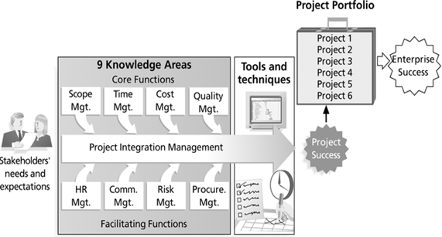
Project Management Framework

Slide 3
The PMBOK® Guide Structure
The Project Management Knowledge Areas
Project management knowledge areas describe the key competencies that project managers must develop
Project scope management
involves defining and managing all the work required to complete the project successfully.
Project time management
includes estimating how long it will take to complete the work, developing an acceptable project schedule, and ensuring timely completion of the project.
Project cost management
consists of preparing and managing the budget for the project.

Slide 4
The Project Management Knowledge Areas
4. Project quality management
ensures that the project will satisfy the stated or implied needs for which it was undertaken.
5. Project communications management
involves generating, collecting, disseminating, and storing project information.
6. Project risk management
includes identifying, analyzing, and responding to risks related to the project
7. Project human resource management
is concerned with making effective use of the people involved with the project.

Slide 5
The Project Management Knowledge Areas
8. Project integration management
is an overarching function that affects and is affected by all of the other knowledge areas.
9. Project procurement management
involves acquiring or procuring goods and services for a project from outside the performing organization
Project stakeholder management
includes identifying and analyzing stakeholder needs while managing and controlling their engagement throughout

Slide 6
Project management tools and techniques by knowledge area
Knowledge Area/Category | Tools and Techniques
1.Integration management | Project selection methods, project management methodologies, stakeholder analyses, work requests, project charters, project management plans, project management software, change requests, change control boards, project review meetings, lessons-learned reports
2. Scope management | Scope statements, work breakdown structures, statements of work, requirements analyses, scope management plans, scope verification techniques, scope change control
3. Time management | Gantt charts, project network diagrams, critical path analysis, crashing, fast tracking, schedule performance measurements
4. Cost management | Project budgets, net present value, return on investment, payback analysis, earned value management, project portfolio management, cost estimates, cost management plans, cost baselines

Slide 7
PM tools and techniques by knowledge area
Knowledge Area/Category | Tools and Techniques
5. Quality management | Quality metrics, checklists, quality control charts, Pareto diagrams, fishbone diagrams, maturity models, statistical methods, test plans
6. Human resource management | Motivation techniques, empathic listening, responsibility assignment matrices, project organizational charts, resource histograms, team building exercises
7. Communications management | Communications management plans, kick-off meetings, conflict management, communications media selection, status and progress reports, virtual communications, templates, project Web sites
8. Risk management | Risk management plans, risk registers, probability/impact matrices, risk rankings
9. Procurement management | Make-or-buy analyses, contracts, requests for proposals or quotes, source sélections, supplier évaluation matrices
10. Stakeholders management | Stakeholder register, Stakeholder management strategy, Project management plan, Issue log, Change log, Communication methods, Interpersonal skills and Management skills

Slide 8
END

